Slide 1
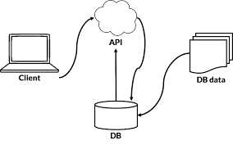

Flask & REST API

Slide 2
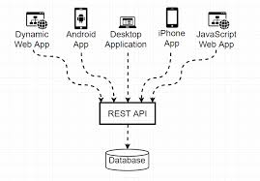
What is REST
REpresentational State Transfer
Its not a standard
Its not a protocol
Its just a architectural style for network application for transferring information/resources

Slide 3
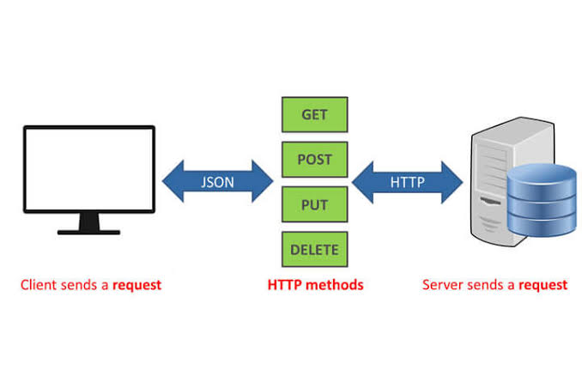
A RESTful WebService
HTTP Protocol
Methods
GET
POST
PUT
DELETE
PATCH

Slide 4
A RESTful WebService
Resource representation by URI’s
Data representation by :
JSON
YAML
XML
HTML

Slide 5

Flask
Its a micro-framework written in Python for the Web
Micro mean simple yet powerful core and highly extensible
Its used to create websites and API’s

Slide 6
Why Flask
Easy to learn
Pythonic
Import only what you need
Flask does not enforce the database to use
Small but it can easily handle large apps
Testable, easy to write unit tests around it

Slide 7
A basic flask app
from flask import Flask
app = Flask(__name__)
def hello_world():
return ‘Hello, World from Flask app!!’
app.run()

Slide 8

Postman Tool
It is used for API testing, mostly RESTapi
We can create collection of your API calls and save it for later use.
We can create tests around api calls.
Its a desktop app, download from below location:
https://www.getpostman.com/downloads/

Slide 9
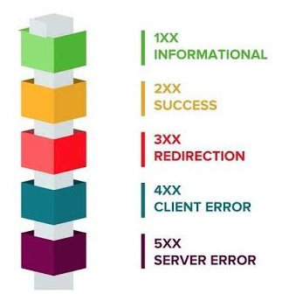
Http status codes
2xx : success | 200 - OK, 201 - Created, 202 - Accepted, 204 - No content
3xx : Redirection | 301 - Moved permanently,
4xx : Client error | 400 - Bad request, 401 - unauthorised, 404 - Not Found
5xx : Server error | 500 - Internal Server error, 501 - Not implemented

Slide 10
Let’s code … create a RESTful api in flask

Slide 11

Thank You!!

